Slide 1


Machine Learning
Lightning talk
phan xuan Phuong
01.12.2020

Slide 2
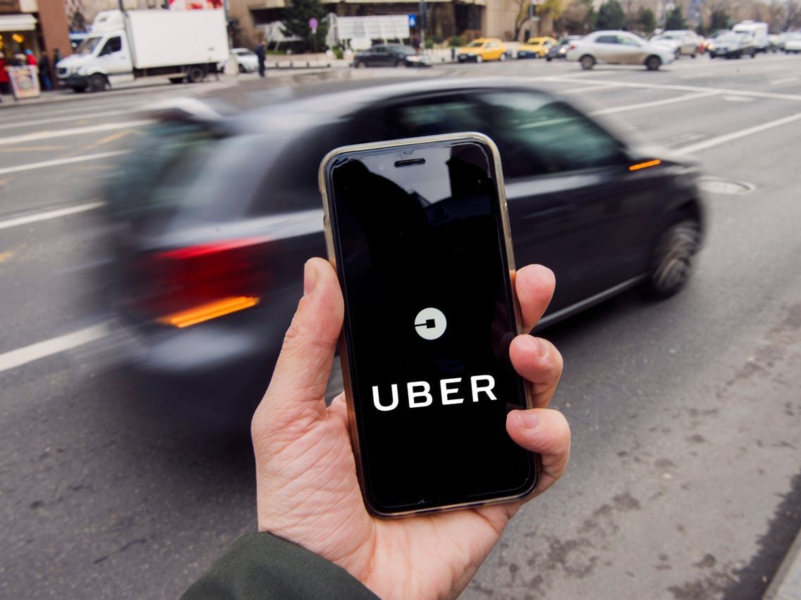

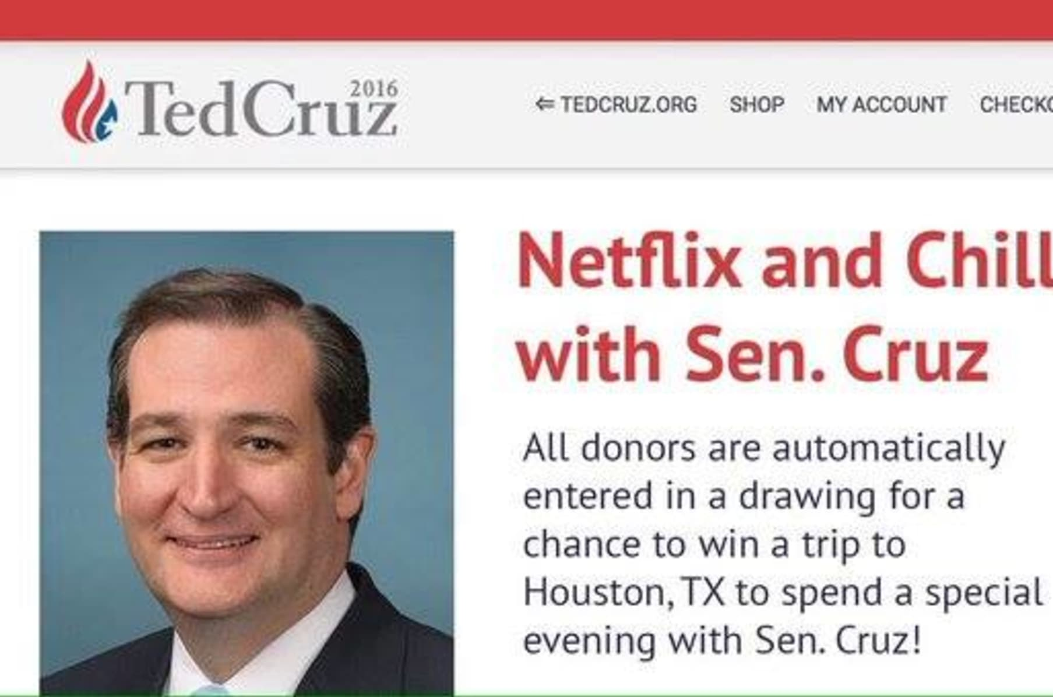
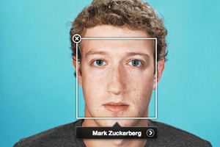

How come?

Slide 3
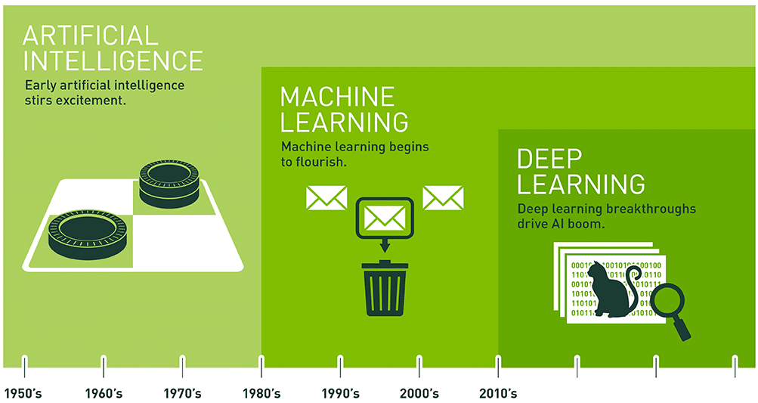
AI, Machine Learning, Deep Learning
Artificial Intelligence
Machine Learning
Using data to answer questions
Deep Learning
Structured algorithms
Neural networks

Slide 4
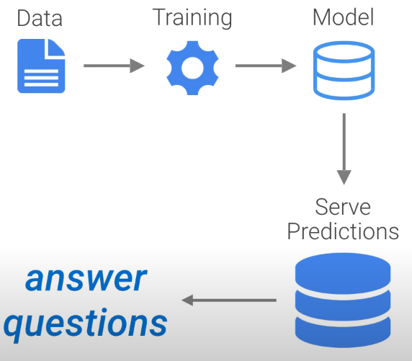
What does it mean?
“Using data to answer questions”
Training
Prediction making
Learning from the data

Slide 5

How is it possible?
Extremely large amounts of data
Online activity
Transactions

Slide 6
Applications of ML
Health Care
Predicted diagnostics for review
Sentiment Analysis
Tech giants, social media
Fraud detection
E-Commerce

Slide 7
Types of Machine Learning
Supervised machine learning
Unsupervised machine learning
Reinforcement machine learning

Slide 8

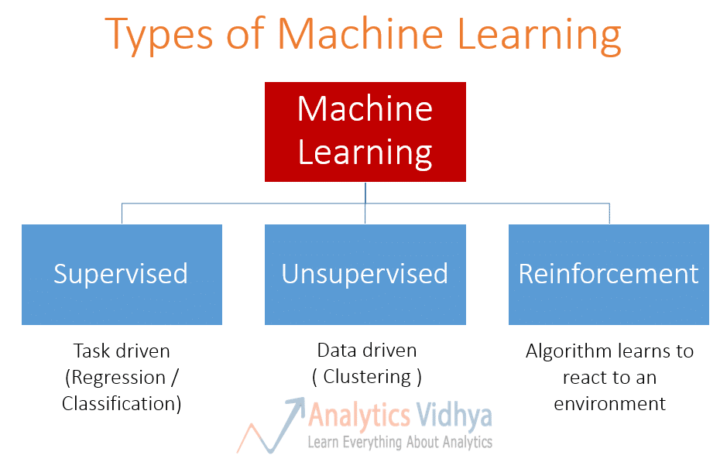



Again

Slide 9
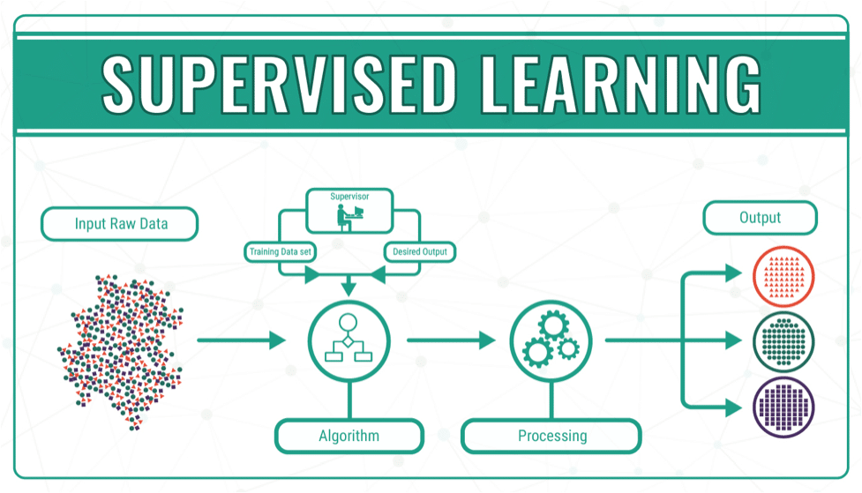
Supervised Machine Learning
Notes:
Examples: House prices
Square footage, number of rooms, features, whether has garden or not – LABELS Image processing – is it a cat or a dog? Weather predicting – historical temperature, wind, humidity,

Slide 10
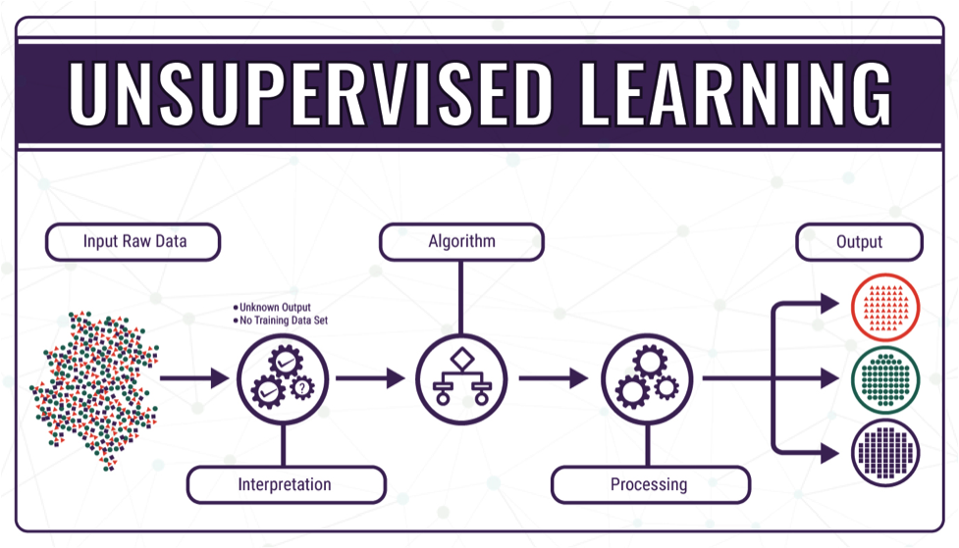
Unsupervised Machine Learning
Notes:
No labels, only input data -> groups and clusters in the making
Different segments of customers -> marketing
gender, age, location, education, income bracket

Slide 11
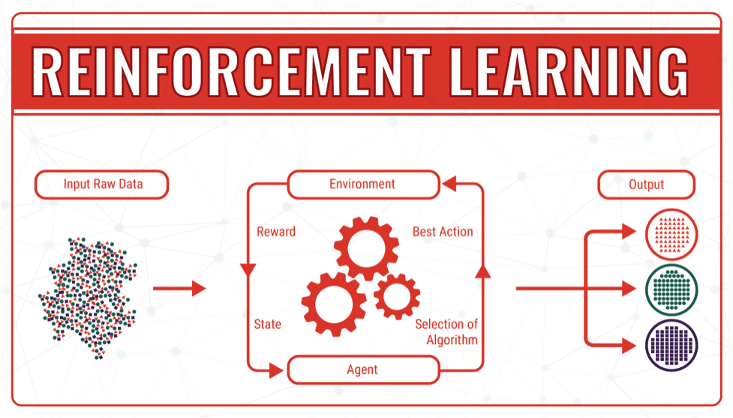
Reinforcement Machine Learning
Notes:
Works on the principle of feedback

Slide 12
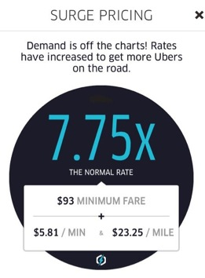
Real life example: Uber
Determining prices real-time
SURGE PRICING
Aka: dynamic / demand / time-based pricing
Based on:
Demand
Cars available
Bad weather
Rush hour
So on..

Slide 13

Driver incentives

Slide 14

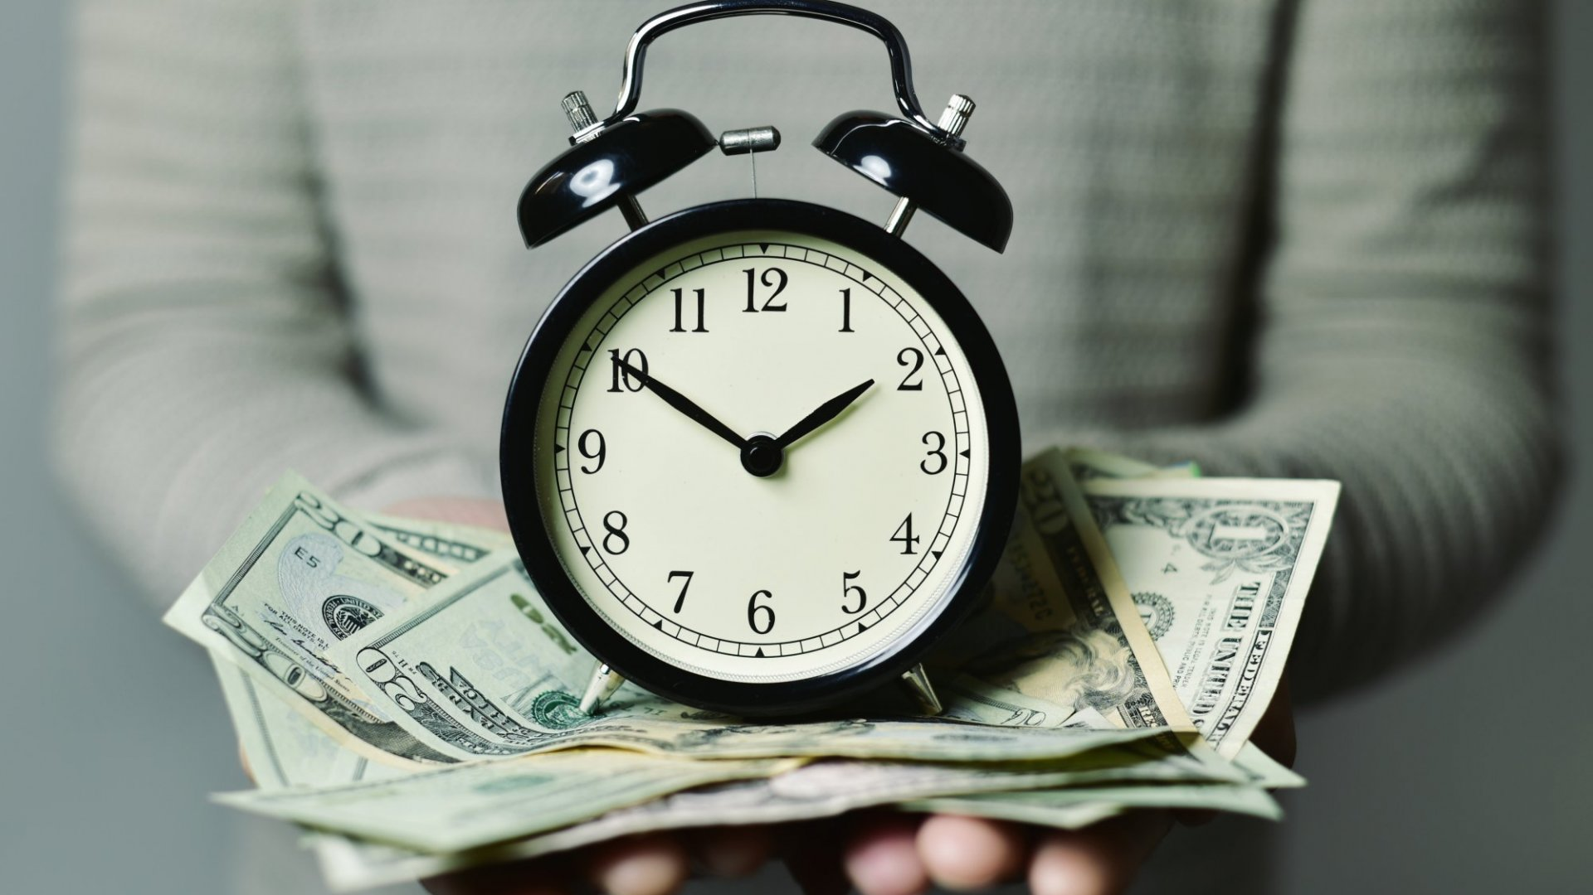
Riders benefits

Slide 15
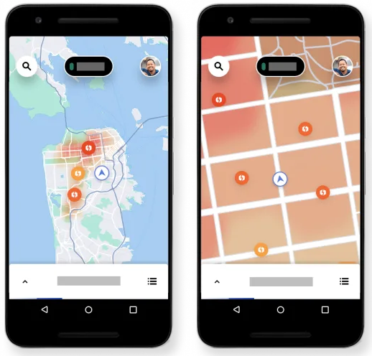
Surge pricing heatmap

Slide 16

Any questions? Any ideas?
Feel free to ask a LICENSED professional instead

Slide 17

Thank you for your attention! =)

